Slide 1
Getting Started with STOKE
(STress intensity Or K Extractor)
02 Sept 2025
Rev -
Lawrence Charles Stoker III, PE
TN License #132718
LawrenceStokerPE@gmail.com
S∫E
Stoker Enterprises

Slide 2
Introduction to STOKE
STress intensity O K Extractor
Modeling, Meshing, and Post-Processing

Slide 3
Introduction
What is STOKE?
  STOKE uses the Contour Integral Method (CIM) to determine Stress Intensity Factors (SIFs or K)
Which FEA packages does STOKE work with?
  Any FEA package that can output averaged corner node values for displacement and stress
  STOKE takes exported results and calculates SIFs outside of the FEA software
Does STOKE cost anything?
  STOKE is currently in beta testing and is FREE to anyone who asks
Does STOKE require a license?
  Yes; the license must be generated and requires your host ID to function correctly

Slide 4
Recommended Meshing Approach
Modeling, Meshing, and Post-Processing

Slide 5
Recommended Meshing Approach
How is the CIM properly?
  Modeling
  Meshing
  Post-Processing
SIFs
Modeling
Post-Processing
Meshing
Notes:
Implementing the CIM is a 3-legged stool.

Slide 6
Recommended Meshing Approach
Modeling
  “Crack Tube” approach
  “Buffer Zone” around crack tube
  Crack is modeled with a very thin subtract feature
    Better to model with non-glue coincident faces, but NX™ can merge nodes when non-manifold geometry is present
    Subtract is more stable
Meshing
  Element size
  Number of refinement rings and biasing
  Number of crack tip elements
  Number of circumferential elements
Post-Processing
  Stress tensor
  Displacements
  Coding
Notes:
The coding is the crucial component of this effort. However, meshing strategy is just as important. The entire processes controls the accuracy of the results.

Slide 7
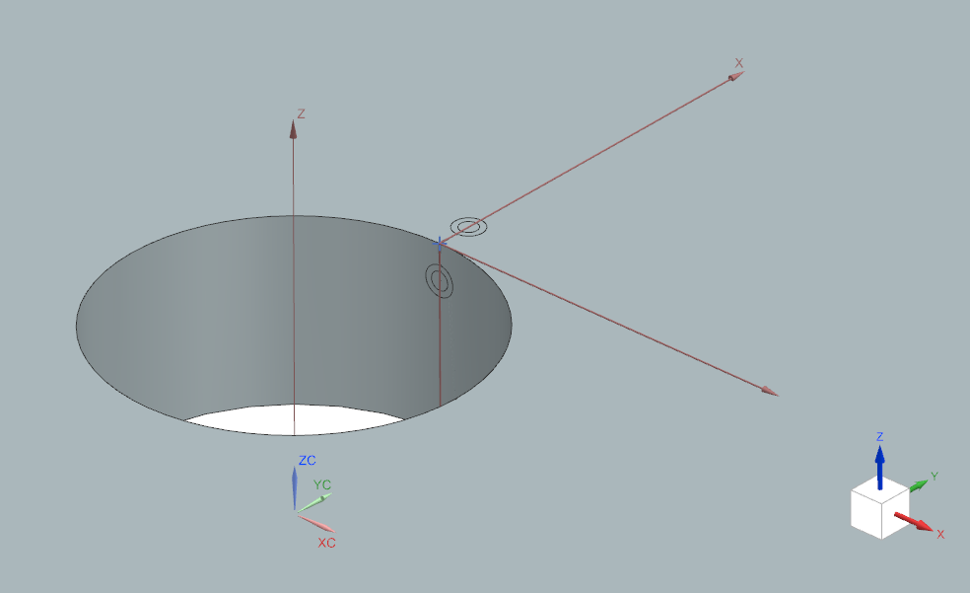
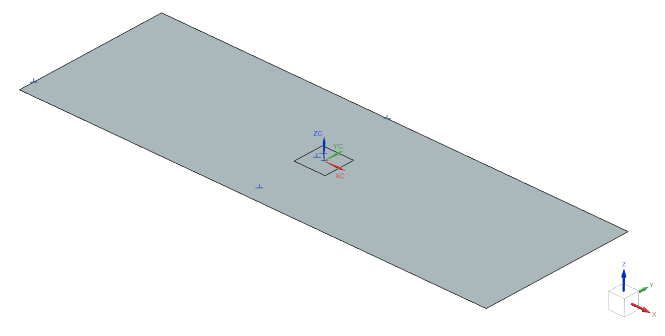
Recommended Meshing Approach
0.050” x 0.050”
100”
Ø 0.50”
20”
300”
t = 0.25”
Notes:
Baseline validation model, which is Model 2 in the ERSI effort.

Slide 8
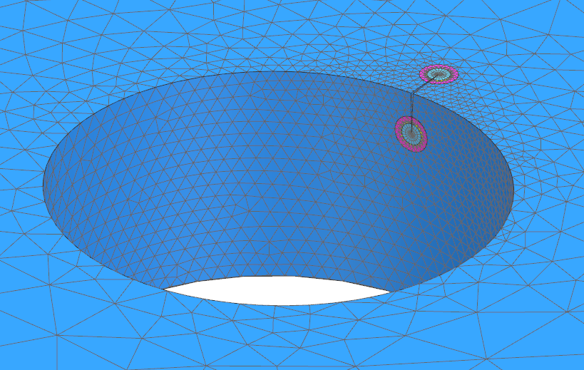
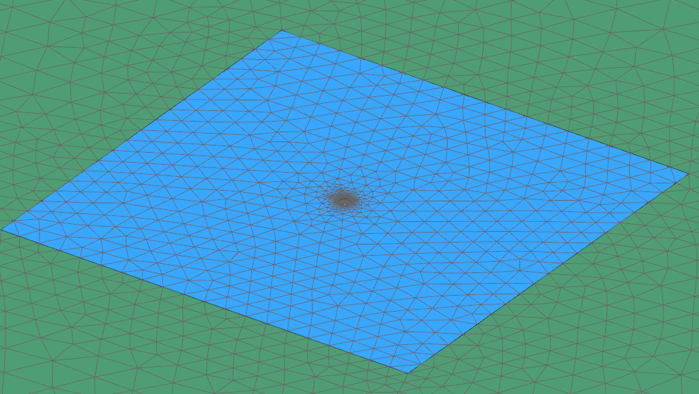
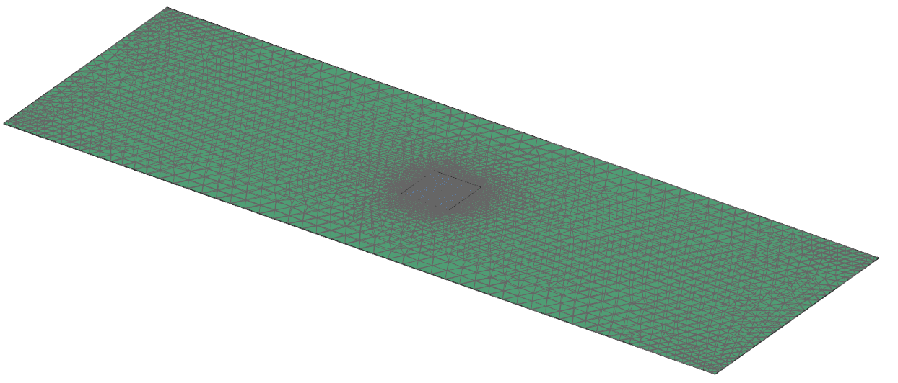
Recommended Meshing Approach
Ø 0.50”
300”
20”

Slide 9
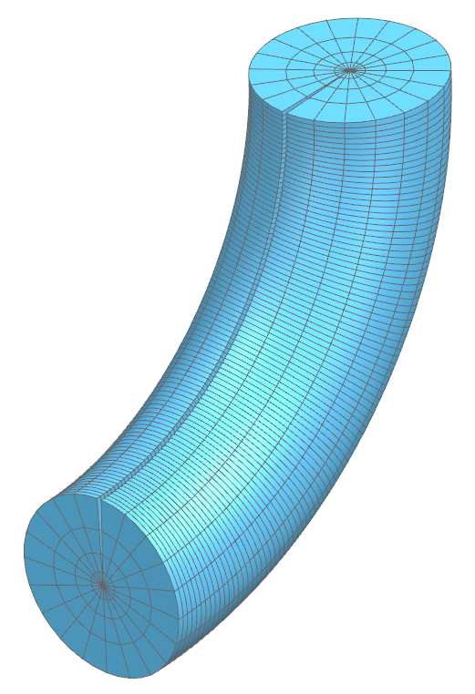
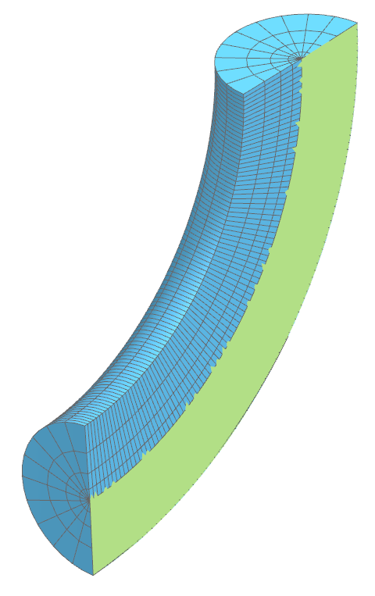
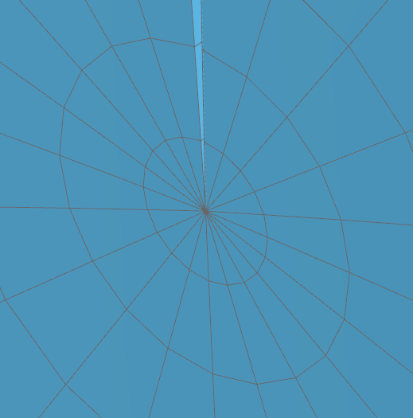
Recommended Meshing Approach
Number of Refinement Layers/Rings
Refinement ring bias (0.75 shown, 1 = equal length)
Crack Tube diameter
(t_{total})
c (0.05” shown)
CPENTA15 “prism” elements
Number of Crack Tip Elements
a
Number of Circumferential Elements
CHEXA20 “brick” elements
% of crack dimension “c”
(0.5∙c = 0.0125” shown)

Slide 10
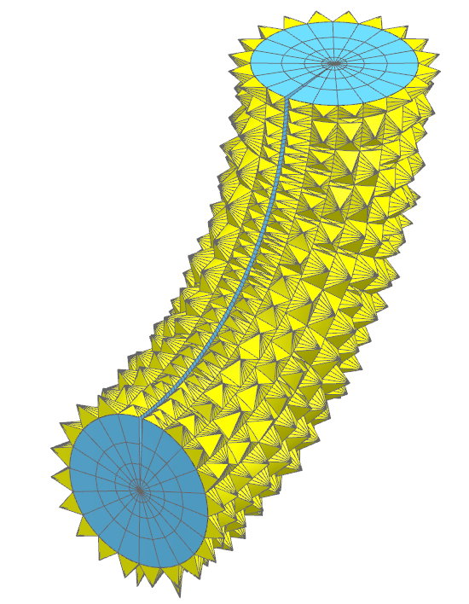
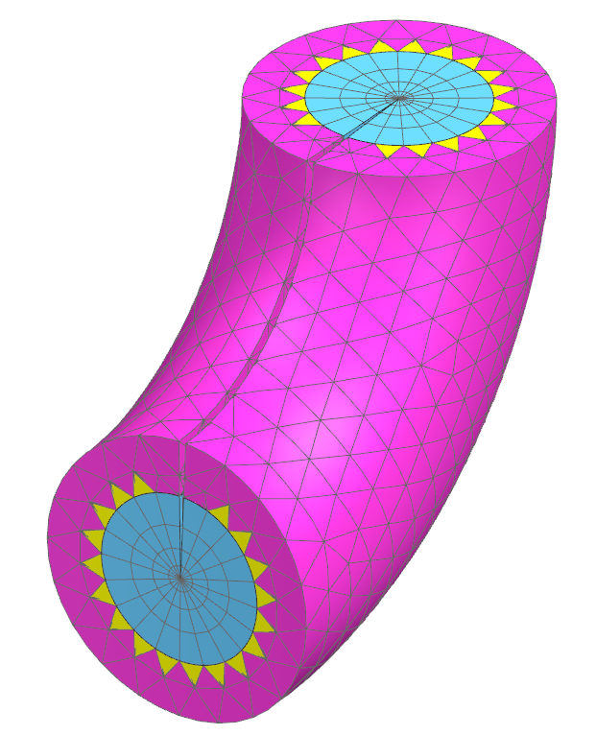
Recommended Meshing Approach
CPYRAM13 Elements
CTETRA10 Elements
(Buffer Zone)
t_{total}/3
(0.00833” shown)

Slide 11

Recommended Meshing Approach
t_{total} = 0.25c, bias = 0.75

Slide 12
Inputs for STOKE
STOKE Excel-based GUI

Slide 13
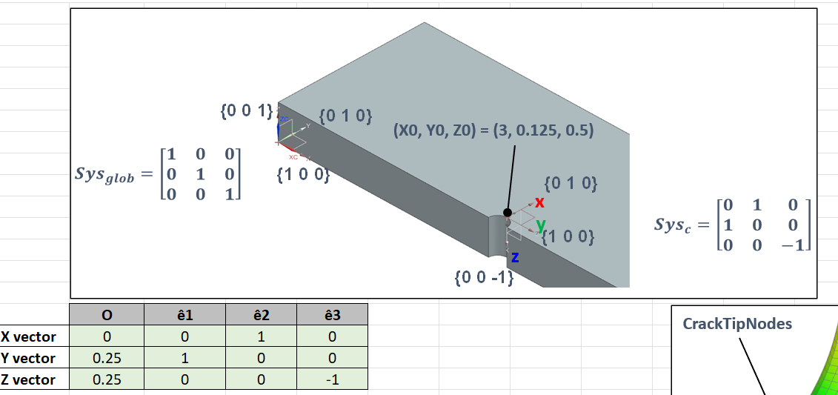
Inputs for STOKE
On “Home” sheet:
Step 1: Enter global info
Example image provided in STOKE interface for reference
Numbers in input table do not need to match
Crack origin (global)
Crack CSYS orientation
(crack plane MUST be on local X-Z plane)

Slide 14
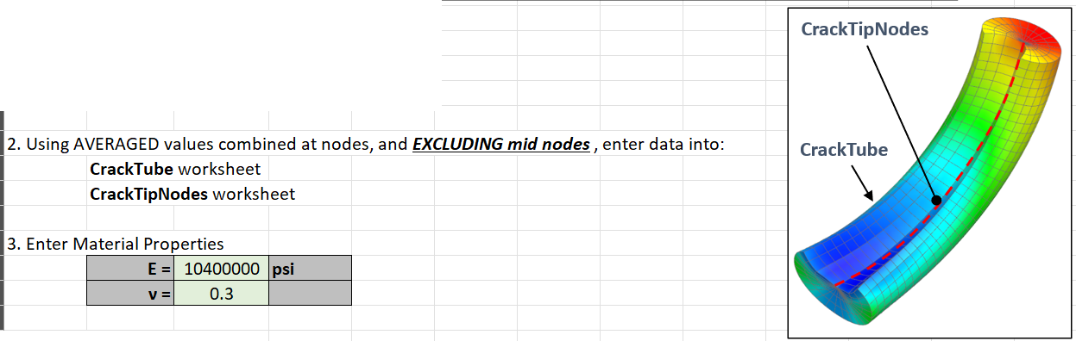
Inputs for STOKE
Step 1: Enter global info
More detail in following slides

Slide 15
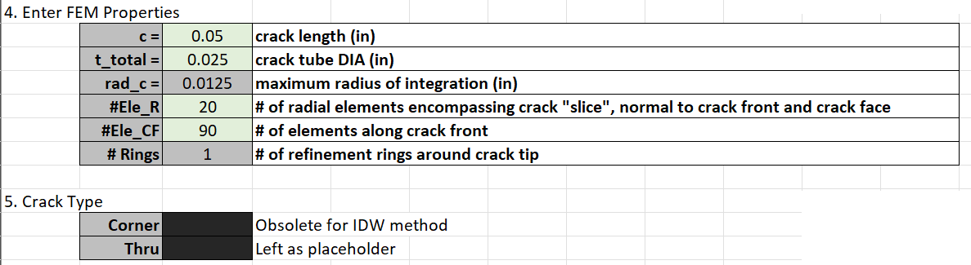
Inputs for STOKE
Step 1: Enter global info
c, t_total, radial elements, and crack front elements must all match your FEM.
c gets a little tricky for arbitrary crack shapes but still works.
This section is a relic from previous nodal search algorithms.
An Inverse Distance Weighting (IDW) method is used now, so these must remain blank.

Slide 16
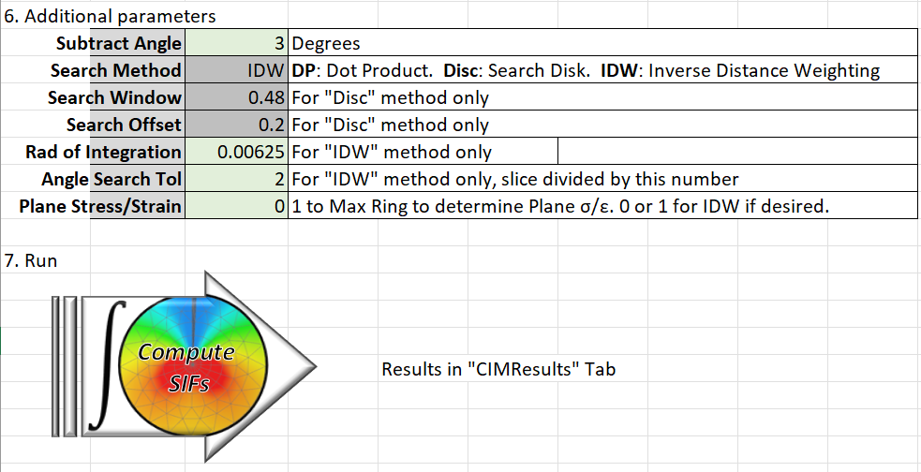
Inputs for STOKE
Step 1: Enter global info
You must specify each of the green cells. Plane stress/strain seems most stable using “0” (determined based on the crack tip node).

Slide 17
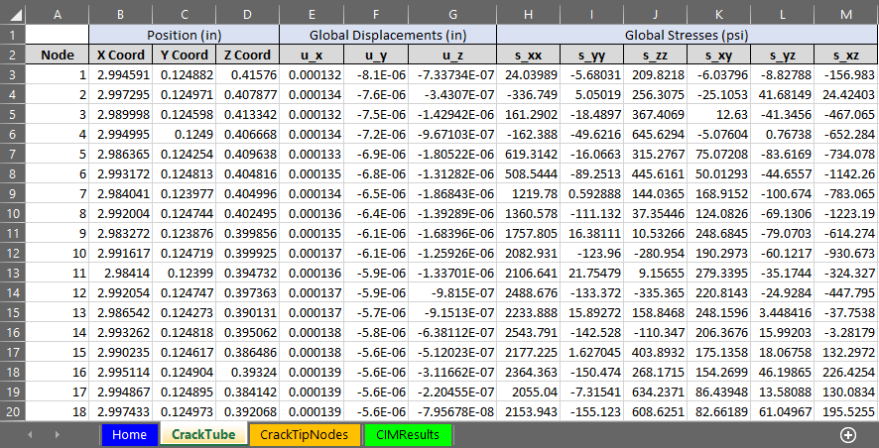
Inputs for STOKE
Step 2: Enter nodal info on “CrackTube” sheet
Must be in this format

Slide 18
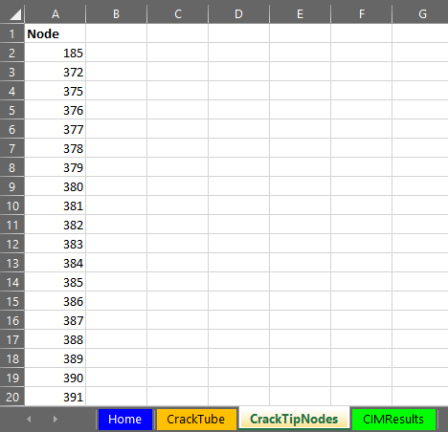
Inputs for STOKE
Step 3: Enter crack tip nodes numbers on “CrackTipNodes” sheet

Slide 19

Inputs for STOKE
Step 4: Compute SIFS
Click this button to run! (Last step)
Results are in “CIMResults” sheet
Process demonstration
(older UI shown)

Slide 20
Conclusion
The CIM is a viable method to extract SIFs with standard h-elements
Best meshing techniques:
  4 refinement rings
  bias=0.75
  t_{total}=0.25c
  Buffer zone=t_{total}/3
  90 crack tip elements
  20 circumferential elements
Convergence demonstrated against other COTS products
  Most within 1%
  Worst within 5%
    Can be “fixed” with alternative meshing and extracting techniques

Slide 21
Conclusion
Shortcomings
  Always validate! (if possible)
  Solution sensitive to meshing
  User experience needs some improvements
  Alternative meshing techniques may be required for different crack shapes
Summary
  Easy to implement
  Solution in the neighborhood of existing COTS solutions
  Can take advantage of NX™’s capabilities and extend to analyze crack tips
  Provides an additional tool in an engineer’s quiver
  User must be cognizant of limitations and sensitivities
Future Work
  Extension to nonlinear?
  Recode for J-integral?
  Connection to AFGROW
  Modify for tractions on crack face

Slide 22
References
[1] | M. Kuna, Finite Elements in Fracture Mechanics, Freiberg, Germany: Springer, 2013.
[2] | "Workshop Proceedings," AFGROW, [Online]. Available: https://www.afgrow.net/workshop/workshop-proceedings.aspx.
[3] | J. R. Rice, "A Path Independent Integral and the Approximate Analysis of Strain Concentration by Notches and Cracks," Brown University, Providence, RI, 1967.
[4] | B. A. Szabo and I. Babuska, "Computation of the Amplitude of Stress Singular Terms for Cracks and Reentrant Corners," Center for Computational Mechanics, Washington University, St. Louis, MO, February 1986.
[5] | L. C. Stoker, "NX Crack and J-Integral Evaluation," in AFGROW Workshop, Layton, UT, 2019.
[6] | J. P. Pereira and C. A. Duarte, "The Contour Integral Method for Loaded Cracks," University of Illinois at Urbana-Champaign, Urbana, IL, 2006.
[7] | C. Wright, "Determination of Small Crack Stress Intensity Factors for an American Society for Testing Materials (ASTM) Middle Tension Test Specimen by Finite Element Method," Air Vehicles Division, Victoria, Australia, 2011.
[8] | R. Dennison and R. L. Actis, "Computation of Accurate SIF's Using the Contour Integral and p-Version of the FEM," in International Conference on Structural Integrity and Failure, Syndey, Australia, 2006.
[9] | C. K. H. Dharan, B. S. Kang and I. Finnie, Finnie's Notes on Fracture Mechanics, New York, NY: Springer, 2016.
[10] | B. Szabo and I. Babuska, Finite Element Analysis: Formulation, Verification and Validation, Hoboken, NJ: John Wiley & Sons, Inc., 2021.
[11] | M. L. Williams, "On the Stress Distribution at the Base of a Stationary Crack," Journal of Applied Mechanics, pp. 109-114, March 1957.
[12] | A. P. Boresi, K. P. Chong and J. D. Lee, Elasticity in Engineering Mechanics, Hoboken, NJ: John Wiley & Sons, Inc., 2011.
[13] | S. Jones, Partial Differential Equations, Online for University of Alabama, 2022.
[14] | G. Strang, Linear Algebra and Its Applications, Belmont, CA: Cengage Learning, 2006.
[15] | C. Castle, "An Investigation of the Through-Thickness Stress Intensity Factor Using P- and H-Element Finite Element Analysis," University of Wisconsin-Milwaukee, Milwaukee, December 2012.
[16] | R. T. Pilarczyk and J. Guymon, "Engineered Residual Stress Implementation (ERSI) Stress Intensity Comparisons Round Robin," Hill Engineering, Clearfield, UT, 2022.
[17] | R. T. Pilarczyk, C. Morrison and J. Hodges, "Benchmarking Problems in Fatigue Crack Growth Analyses," in AFGROW Workshop 2016, Layton, UT, 2016.
[18] | L. C. Stoker, "Investigating SIF Extractions using Solver Agnostic Tools," in AFGROW Workshop, Layton, UT, 2021.
[19] | P. C. Miedlar, A. P. Berens, A. Gunderson and J. P. Gallagher, "USAF Damage Tolerant Design Handbook: Guidelines for the Analysis and Design of Damage Tolerant Aircraft Structures," 03 January 2002. [Online]. Available: https://www.afgrow.net/applications/DTDHandbook/default.aspx. [Accessed 25 July 2023].
[20] | C. King, "Procedure for Developing Stress Intensity Factor (SIF or K) Solutions in StressCheck," US Air Force, 2010.
[21] | J. A. Harter, "An Alternate Closed-Form Stress Intensity Solution for Single Part-Through and Through-the-Thickness Cracks at Offset Holes," Air Vehicles Directorate, AFRL, Wright-Patterson AFB, OH, 1998.
[22] | S. K. Chan, I. S. Tuba and W. K. Wilson, "On the Finite Element Method in Linear Fracture Mechanics," Engineering Fracture Mechanics, vol. 2, pp. 1-17, 1970.
[23] | J. N. Reddy, Introduction to the Finite Element Method, McGraw-Hill Education, 2019.

